Slide 1


SERVERLESS ARCHITECTURE ON AWS
MYKHAYLO STEPANYAK

Slide 2
CONSTRAINTS AND LIMITATIONS
AGENDA
What is serverless computing?
Case studies
AWS - a closer look
Serverless Providers
Serverless Architecture
API Gateway & AWS Lambda
Security Best Practices
Serverless Deployment
Case Studies
Is AWS Serverless for your App?

Slide 3



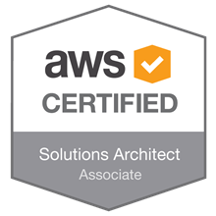

ABOUT ME
Mykhaylo Stepanyak
@mstepanyak
In industry since 2007
Solution Architect at EPAM Systems
Business Domains:
Networking
Healthcare
Retail
Recruitment
Distributed complex systems
Cloud Infrastructure
BigData, IoT
Professional

Slide 4
CONSTRAINTS AND LIMITATIONS
SERVER
Idle, but powered up, servers consume an untoward amount of this energy - and they’re a big part of the reason why we need so many, and bigger data centers:
Typical servers in business and enterprise data centers deliver between 5 and 15 percent of their maximum computing output on average over the course of the year.
-- Forbes

Slide 5

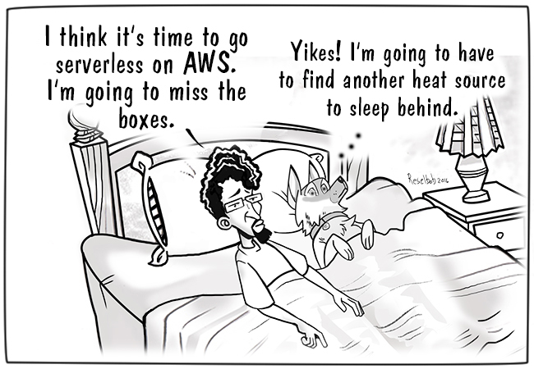
CONSTRAINTS AND LIMITATIONS
WHAT IS SERVERLESS COMPUITING?
Serverless architecture is the latest implementation technique for the increasingly popular event-driven system architecture.

Slide 6
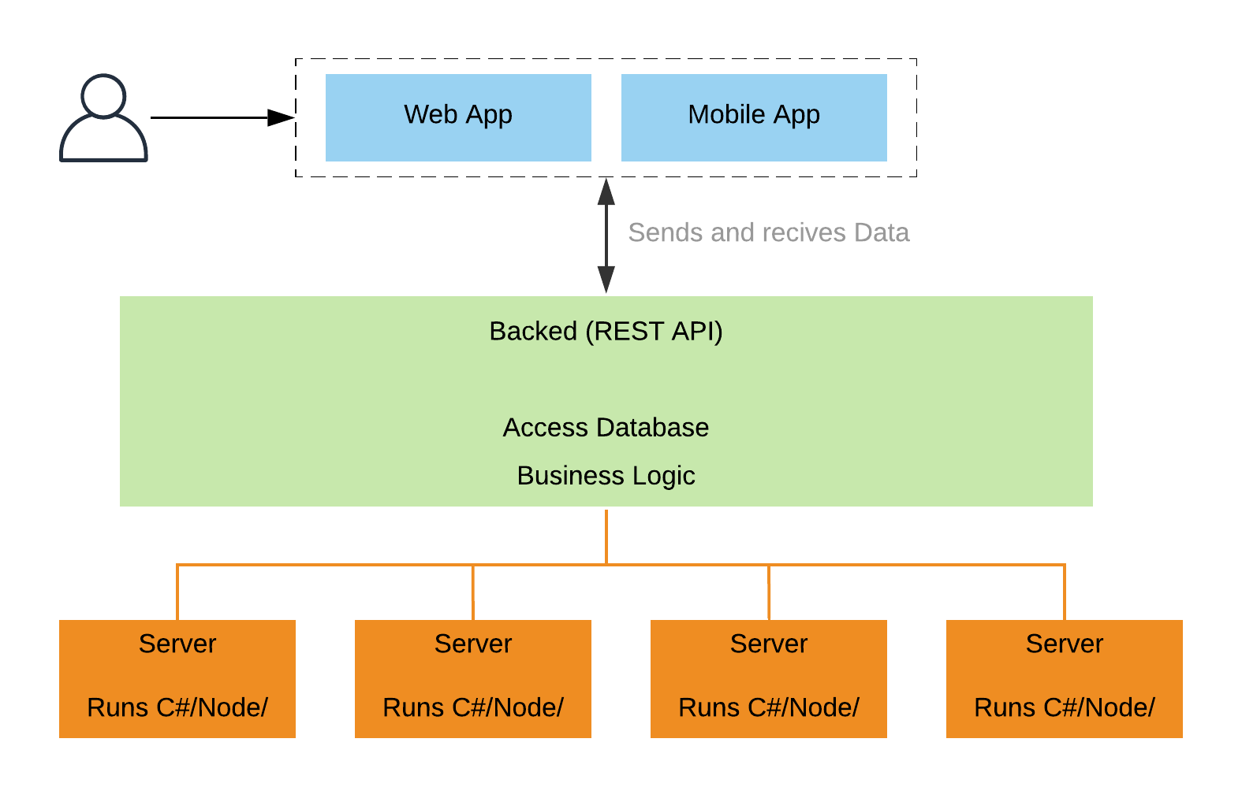
CONSTRAINTS AND LIMITATIONS
TRADITIONAL WEB HOSTING - APPS

Slide 7
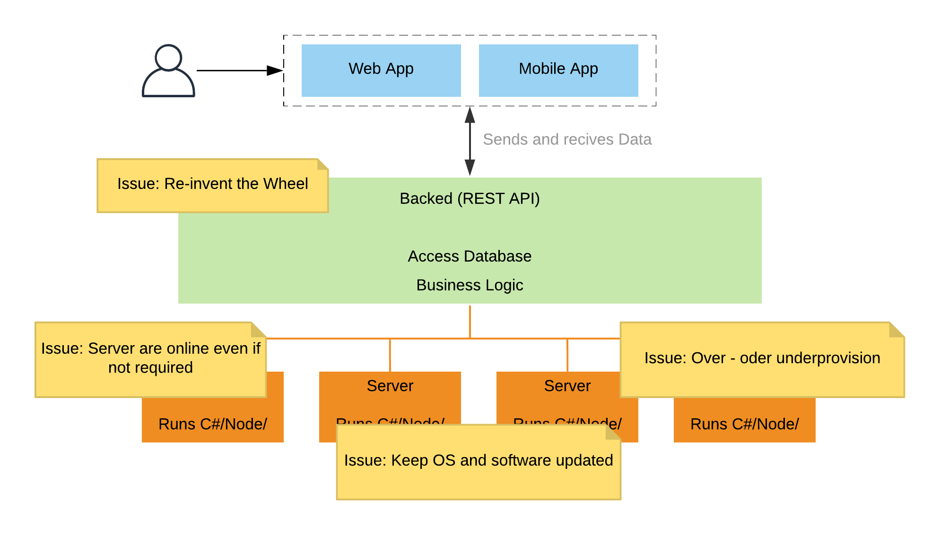
CONSTRAINTS AND LIMITATIONS
TRADITIONAL WEB HOSTING - APPS

Slide 8
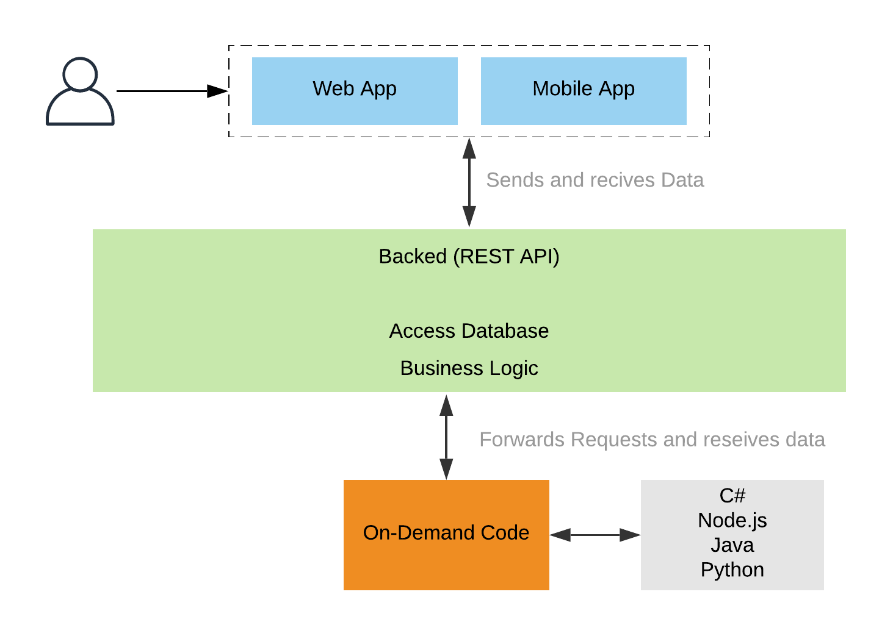
CONSTRAINTS AND LIMITATIONS
SERVERLESS - APPS

Slide 9
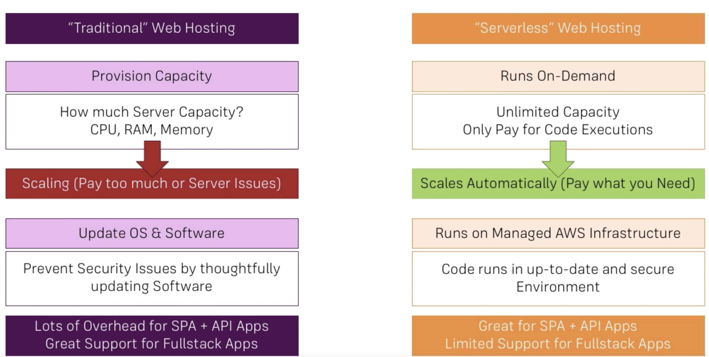
CONSTRAINTS AND LIMITATIONS
TRADITIONAL VS SERVERLESS

Slide 10
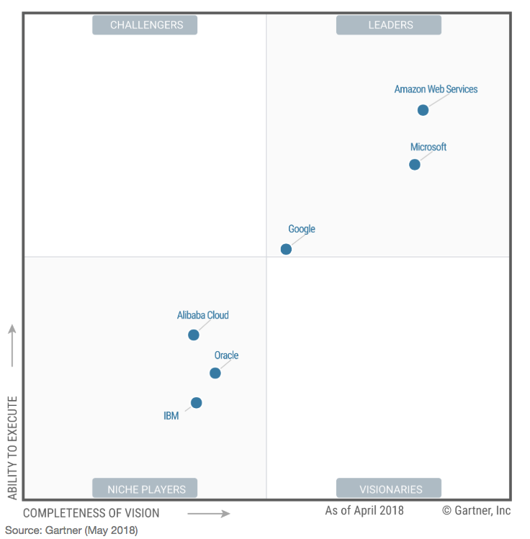
CONSTRAINTS AND LIMITATIONS
MAGIC QUADRANT FOR PUBLIC CLOUDS

Slide 11


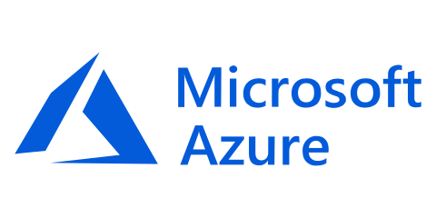

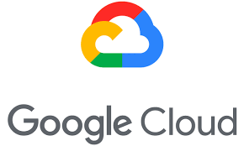

CONSTRAINTS AND LIMITATIONS
SERVERLESS PROVIDERS
- AWS Lambda
- Azure Functions
- Google Cloud Functions

Slide 12
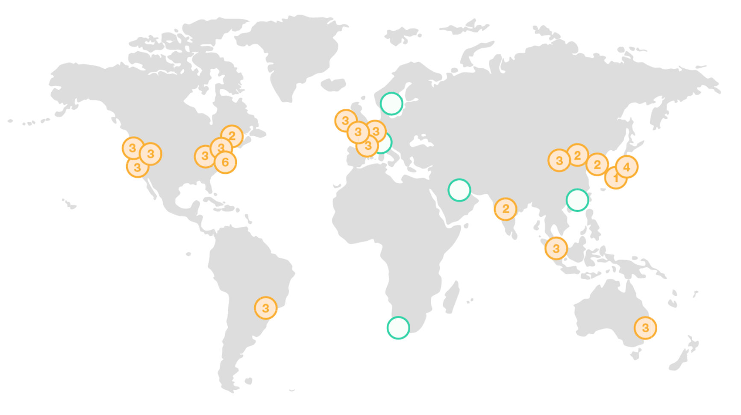
CONSTRAINTS AND LIMITATIONS
AWS GLOBAL INFRASTRUCTURE
1. Regions: 19 five more AWS Regions in Bahrain, Cape Town, Hong Kong SAR, Milan, and Stockholm
2. Availability Zones: 57 with announced plans for 15 more
3. Edge Locations: 30+

Slide 13
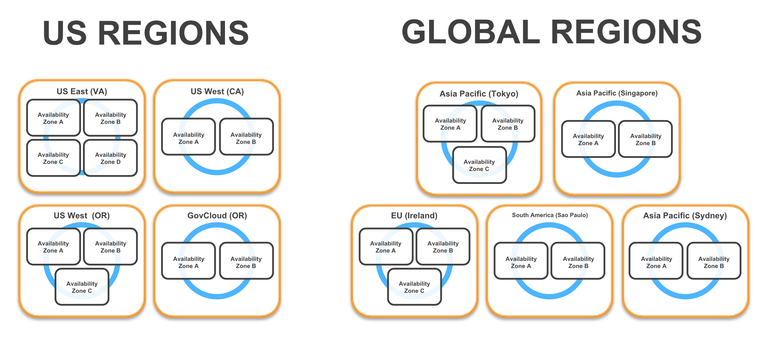
CONSTRAINTS AND LIMITATIONS
CUSTOMER DESIDES WHERE APP AND DATA RESIDE

Slide 14
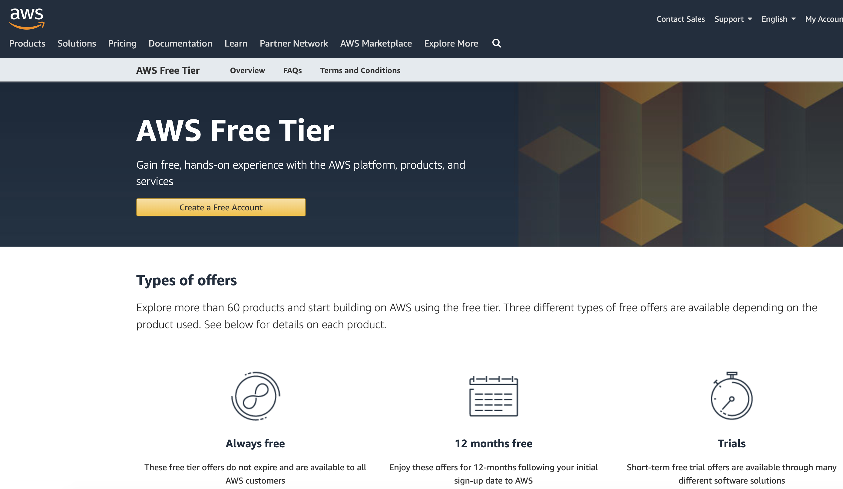
CONSTRAINTS AND LIMITATIONS
https://aws.amazon.com/free/

Slide 15
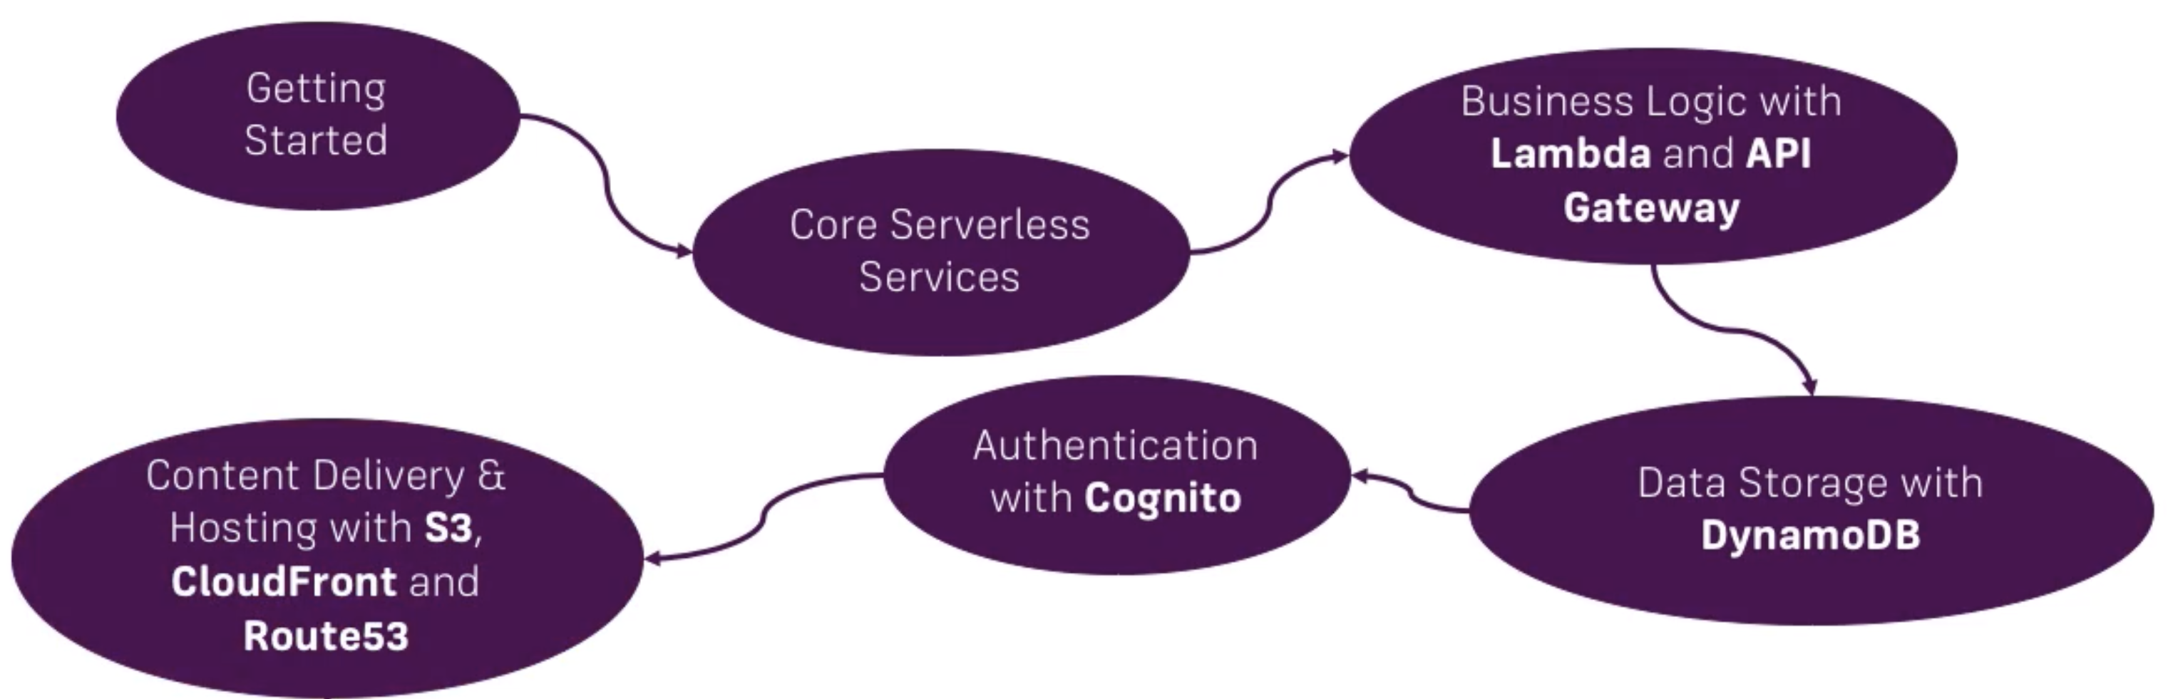
CONSTRAINTS AND LIMITATIONS
CORE AWS SERVERLESS SERVICES

Slide 16
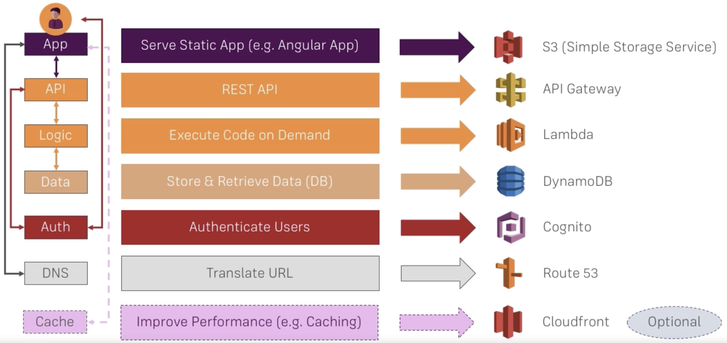
CONSTRAINTS AND LIMITATIONS
WHICH SERVICES DO WE NEED

Slide 17
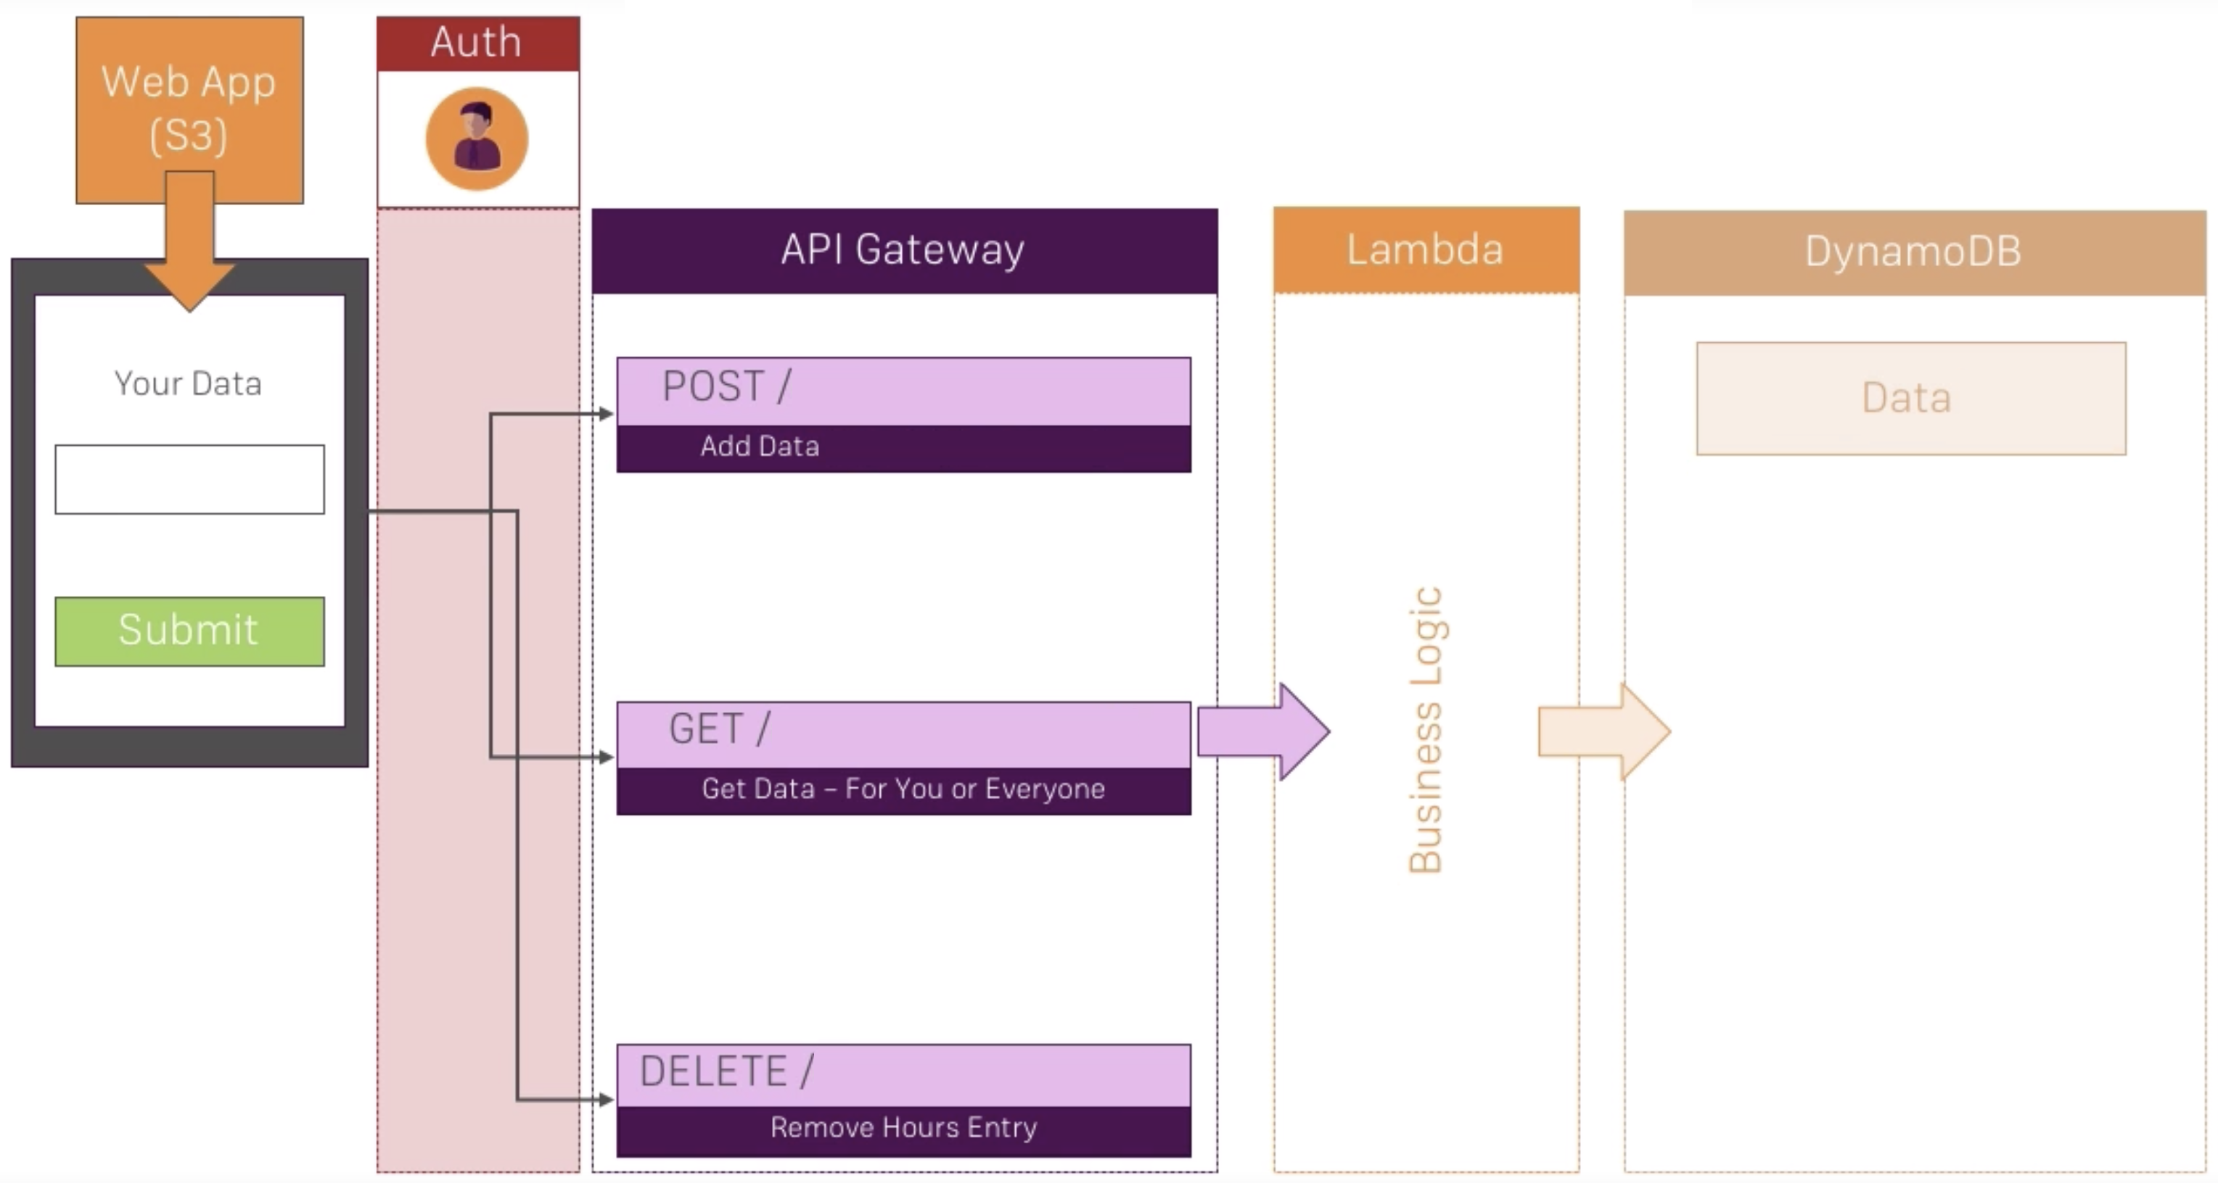
CONSTRAINTS AND LIMITATIONS
SERVERLESS WORKFLOW

Slide 18
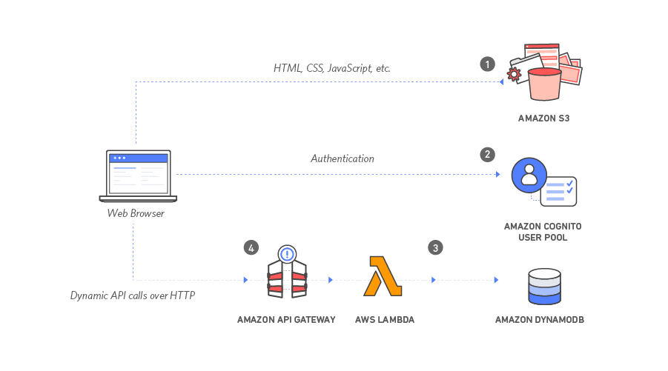
CONSTRAINTS AND LIMITATIONS
APPLICATION ARCHITECTURE

Slide 19
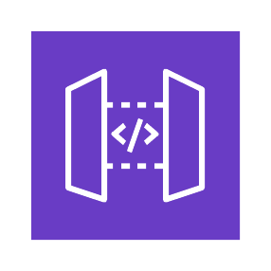

CONSTRAINTS AND LIMITATIONS
WHAT IS API GATEWAY?
AWS Gateway
Creating a RESTful API with ease

Slide 20
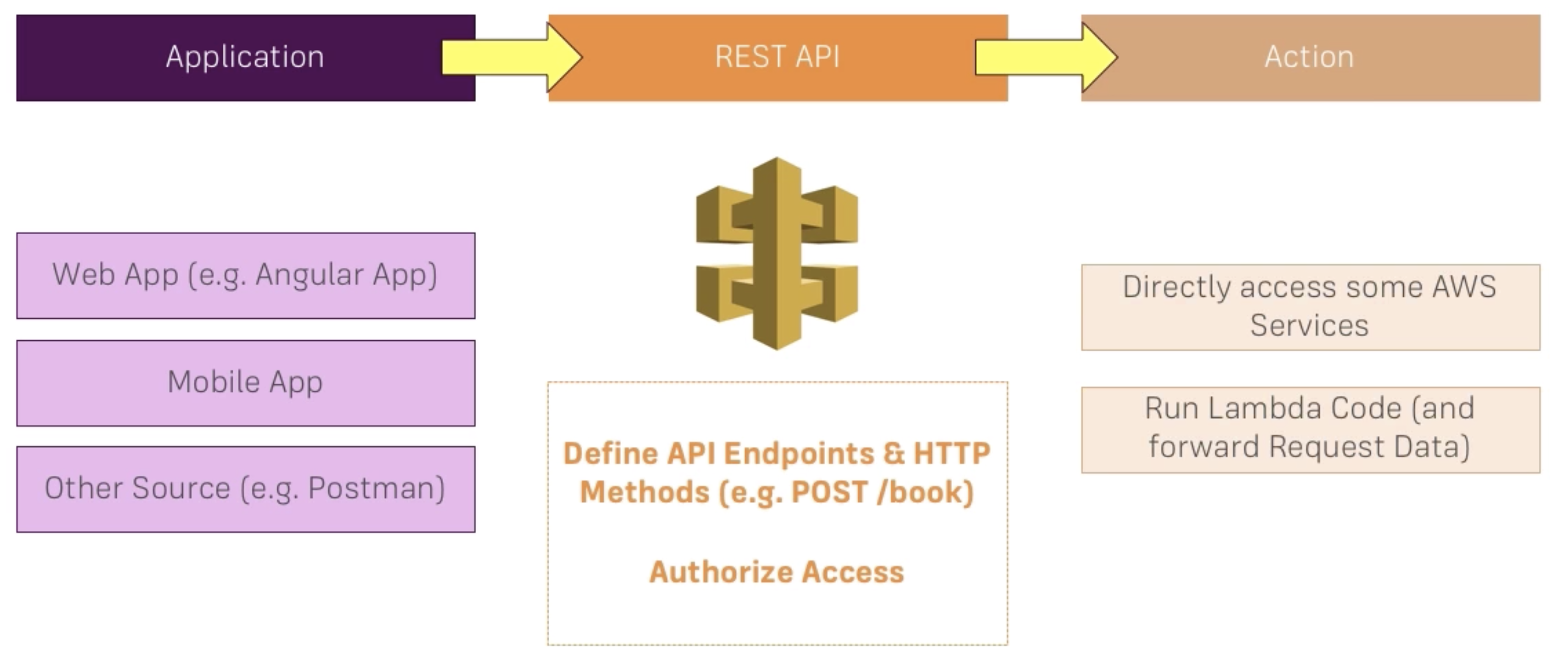
CONSTRAINTS AND LIMITATIONS
AWS API GATEWAY – HOW IT WORKS

Slide 21
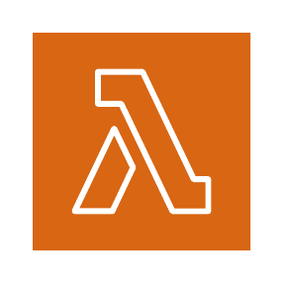
CONSTRAINTS AND LIMITATIONS
WHAT IS AWS LAMBDA?
AWS Lambda
On-demand computing

Slide 22
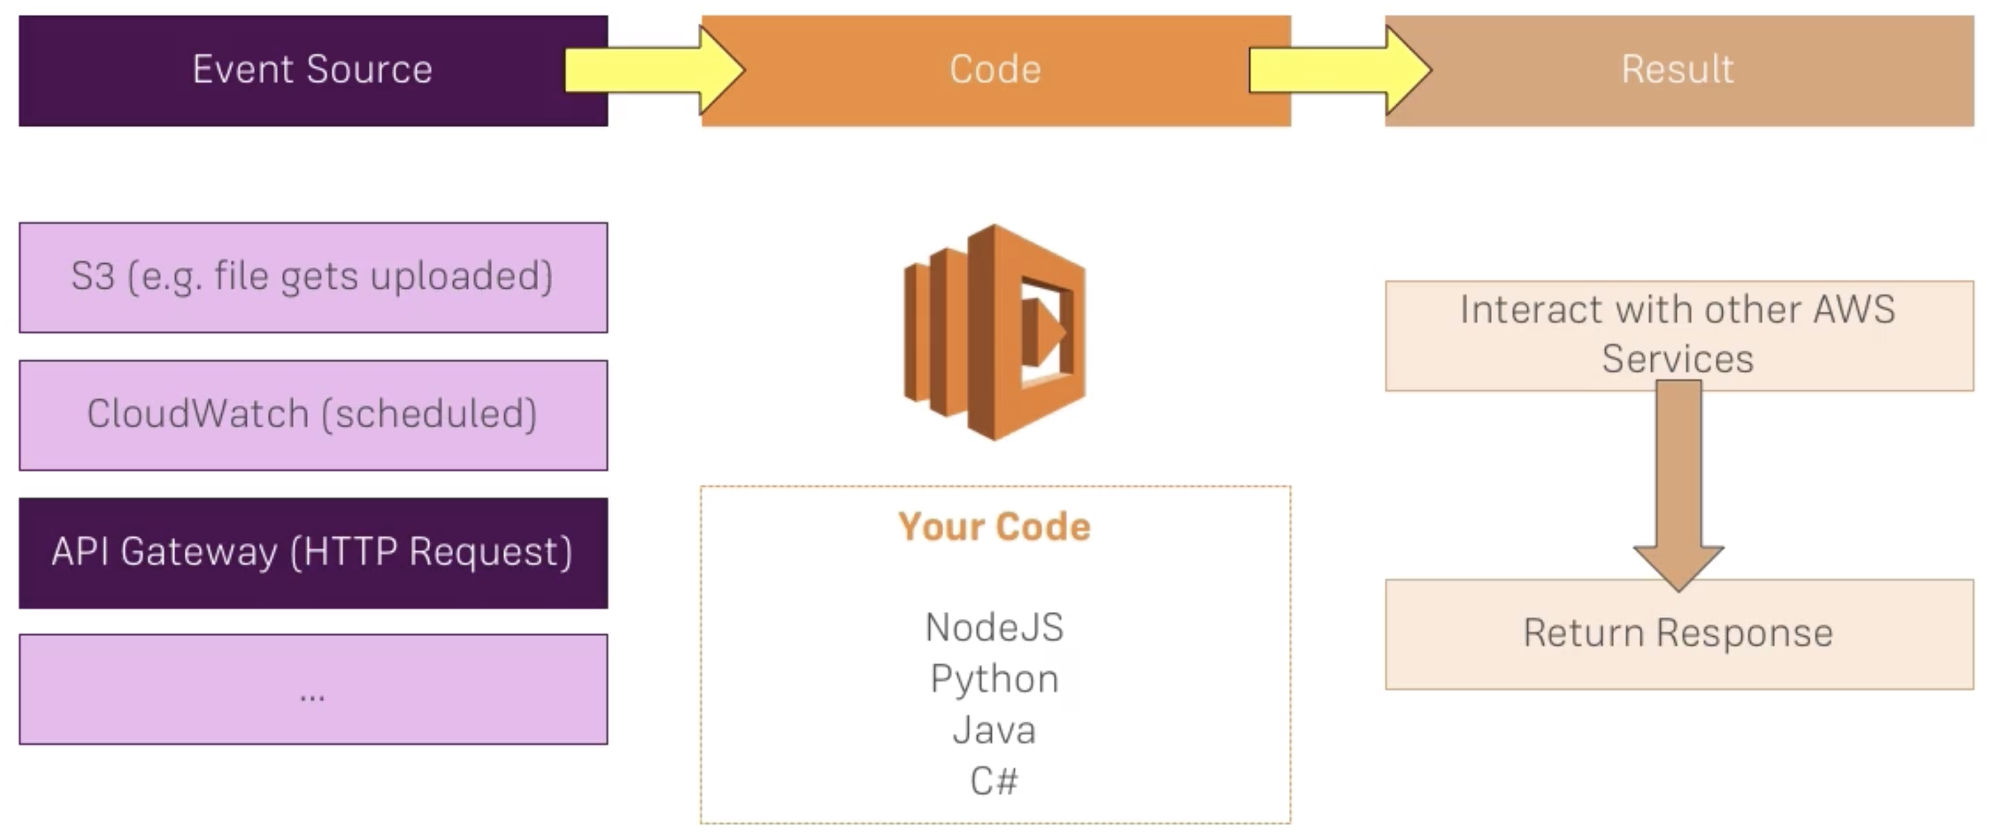
CONSTRAINTS AND LIMITATIONS
AWS LAMBDA - HOW IT WORKS

Slide 23
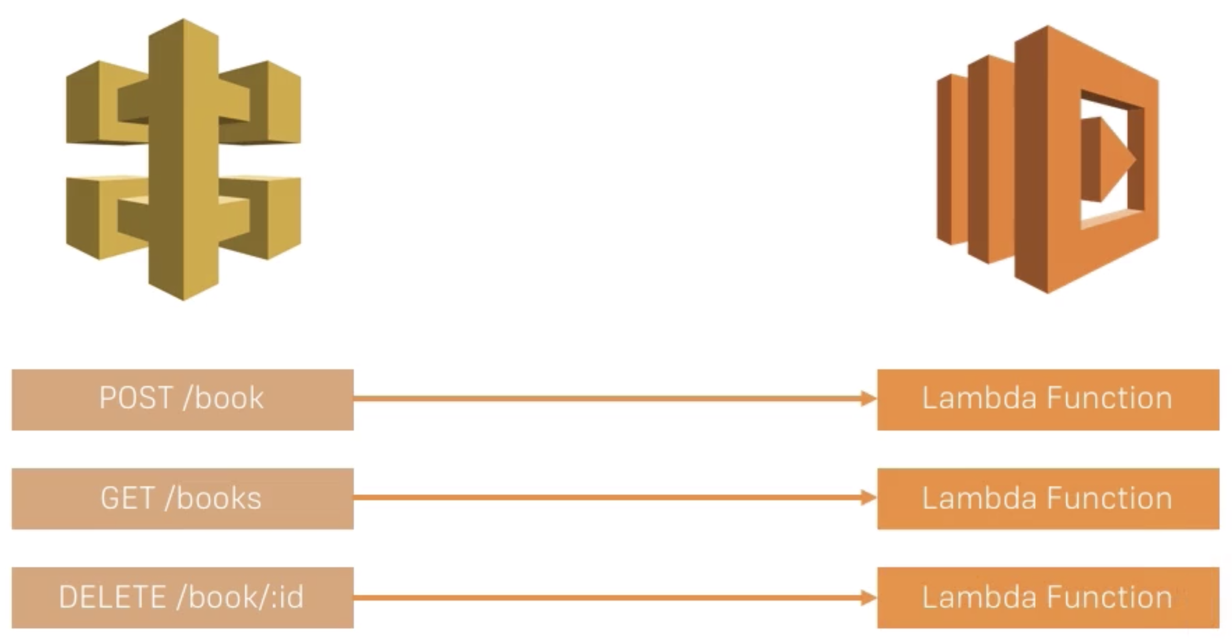
CONSTRAINTS AND LIMITATIONS
AWS API GATEWAY + AWS LAMBDA

Slide 24

CONSTRAINTS AND LIMITATIONS
WHAT IS AWS DYNAMODB?
AWS DynamoDB
Managing data

Slide 25
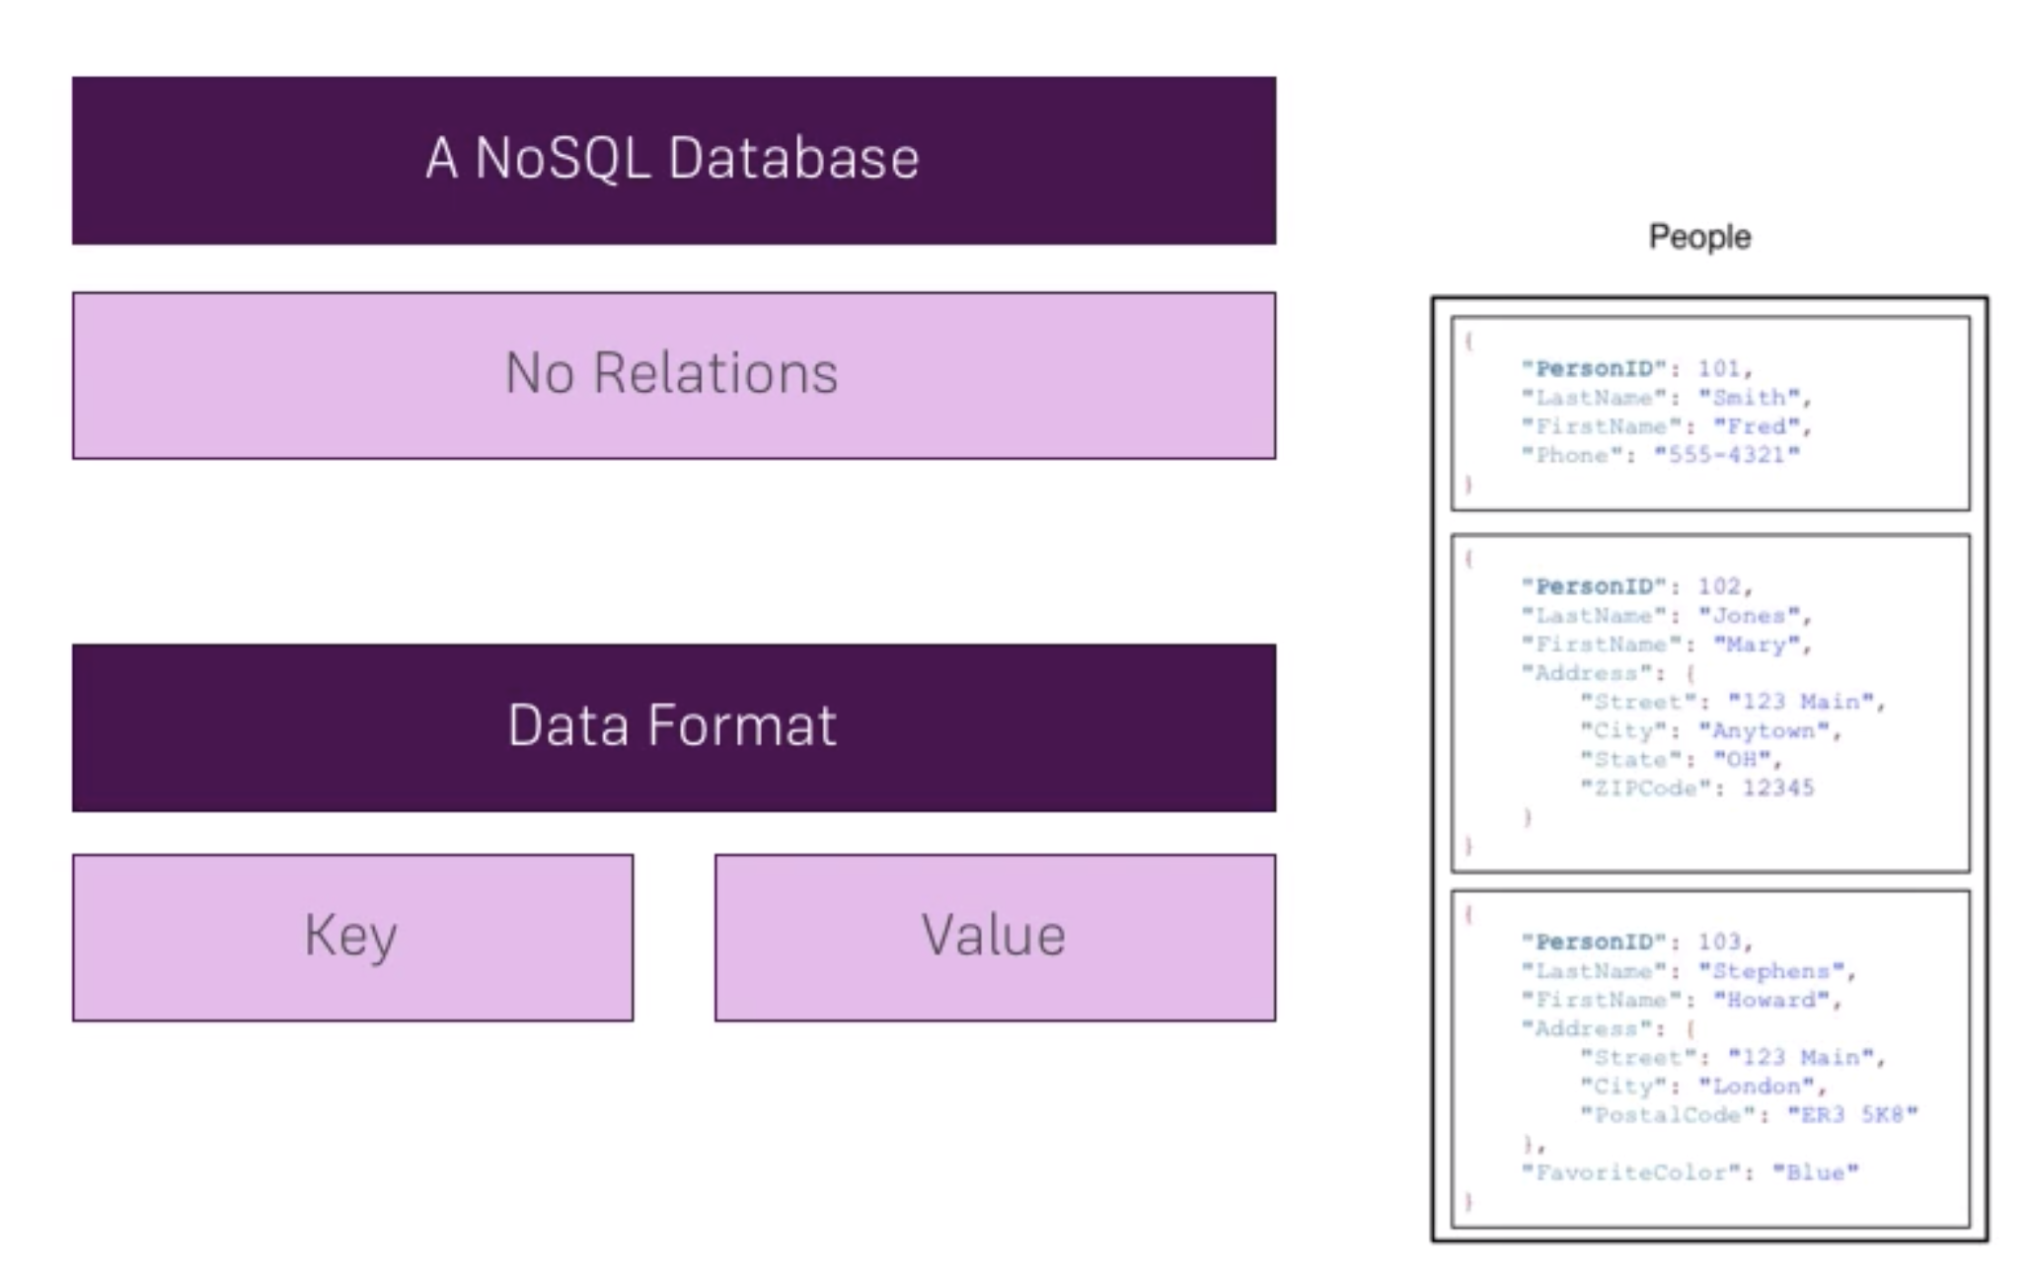
CONSTRAINTS AND LIMITATIONS
AWS DYNAMODB – HOW IT WORKS

Slide 26

CONSTRAINTS AND LIMITATIONS
WHAT IS AWS COGNITO?
AWS Cognito
Adding authentication

Slide 27
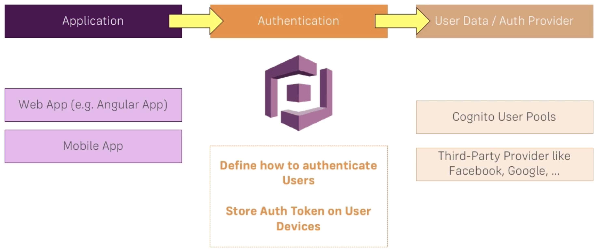
CONSTRAINTS AND LIMITATIONS
AWS COGNITO – HOW IT WORKS

Slide 28
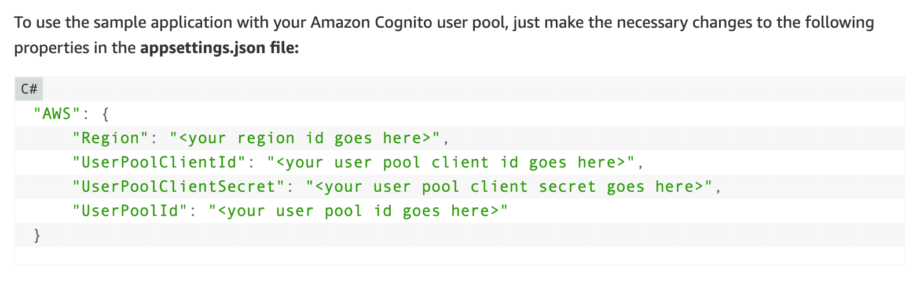
CONSTRAINTS AND LIMITATIONS
AWS COGNITO – HOW IT WORKS

Slide 29
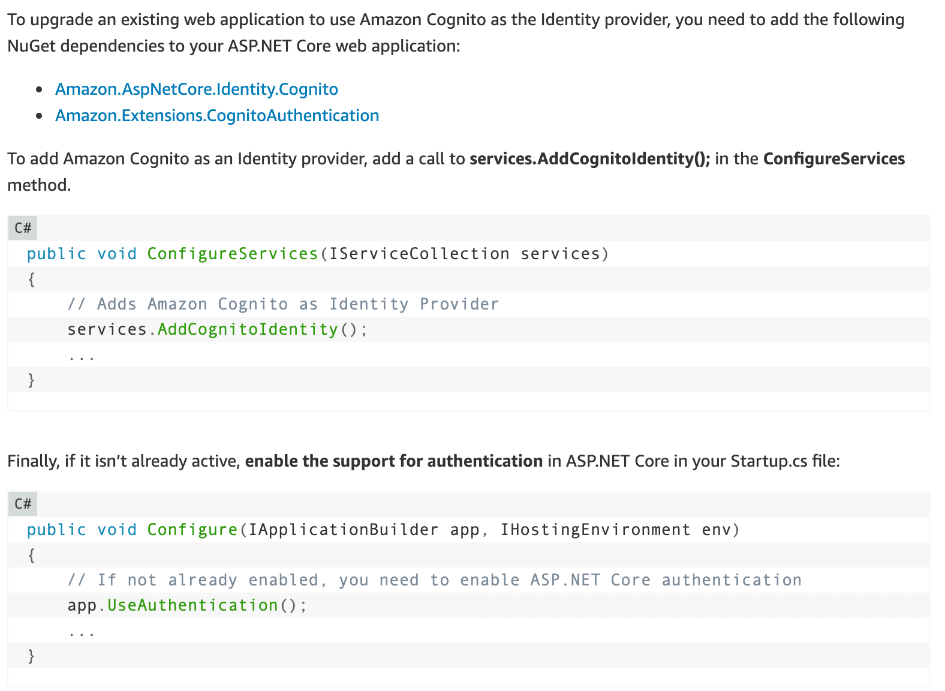
CONSTRAINTS AND LIMITATIONS
AWS COGNITO – HOW IT WORKS

Slide 30

CONSTRAINTS AND LIMITATIONS
WHAT IS AWS S3?
AWS S3
Serving your static page

Slide 31
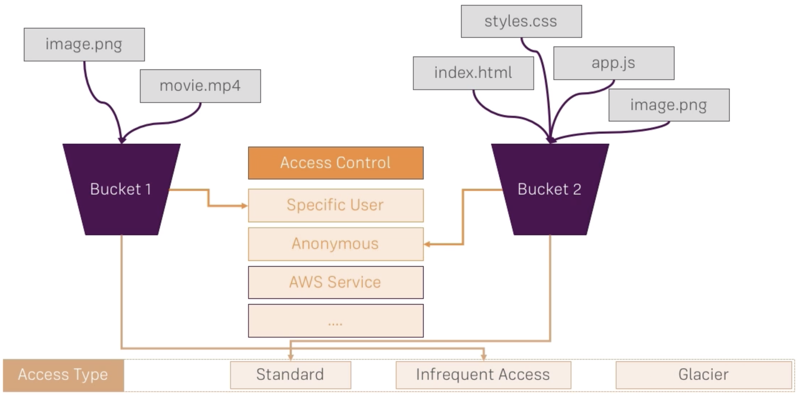
CONSTRAINTS AND LIMITATIONS
AWS S3 – HOW IT WORKS

Slide 32
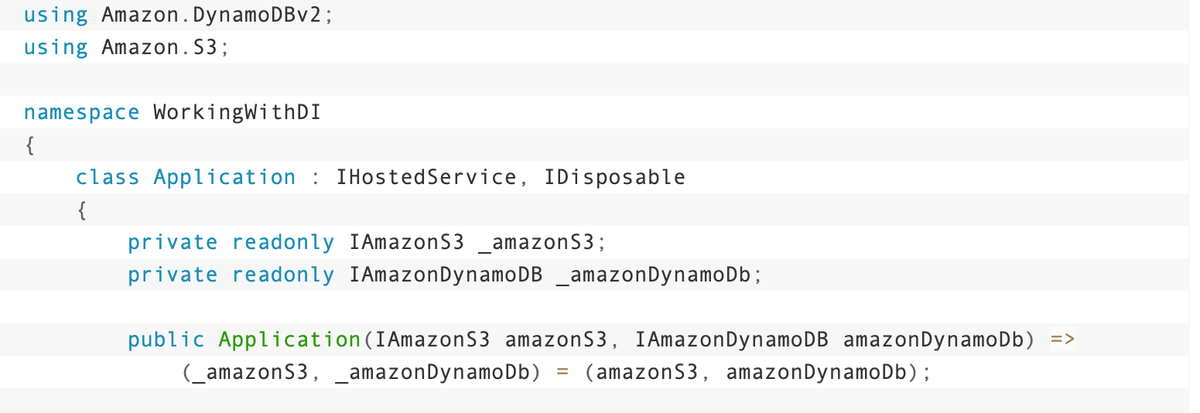
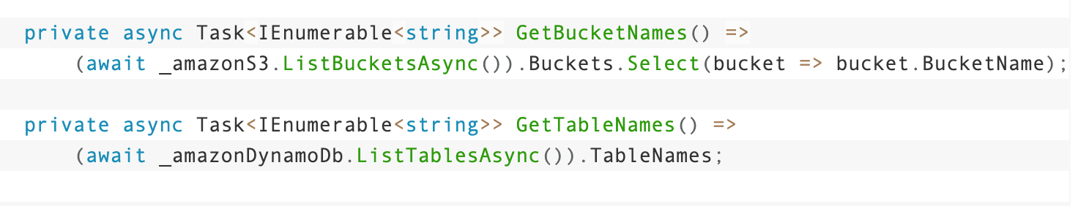
CONSTRAINTS AND LIMITATIONS
AWS S3 – HOW IT WORKS

Slide 33

CONSTRAINTS AND LIMITATIONS
WHAT IS AWS ROUTE 53?
https://lviv.dotnet.city/ instead of 185.67.2.20

Slide 34
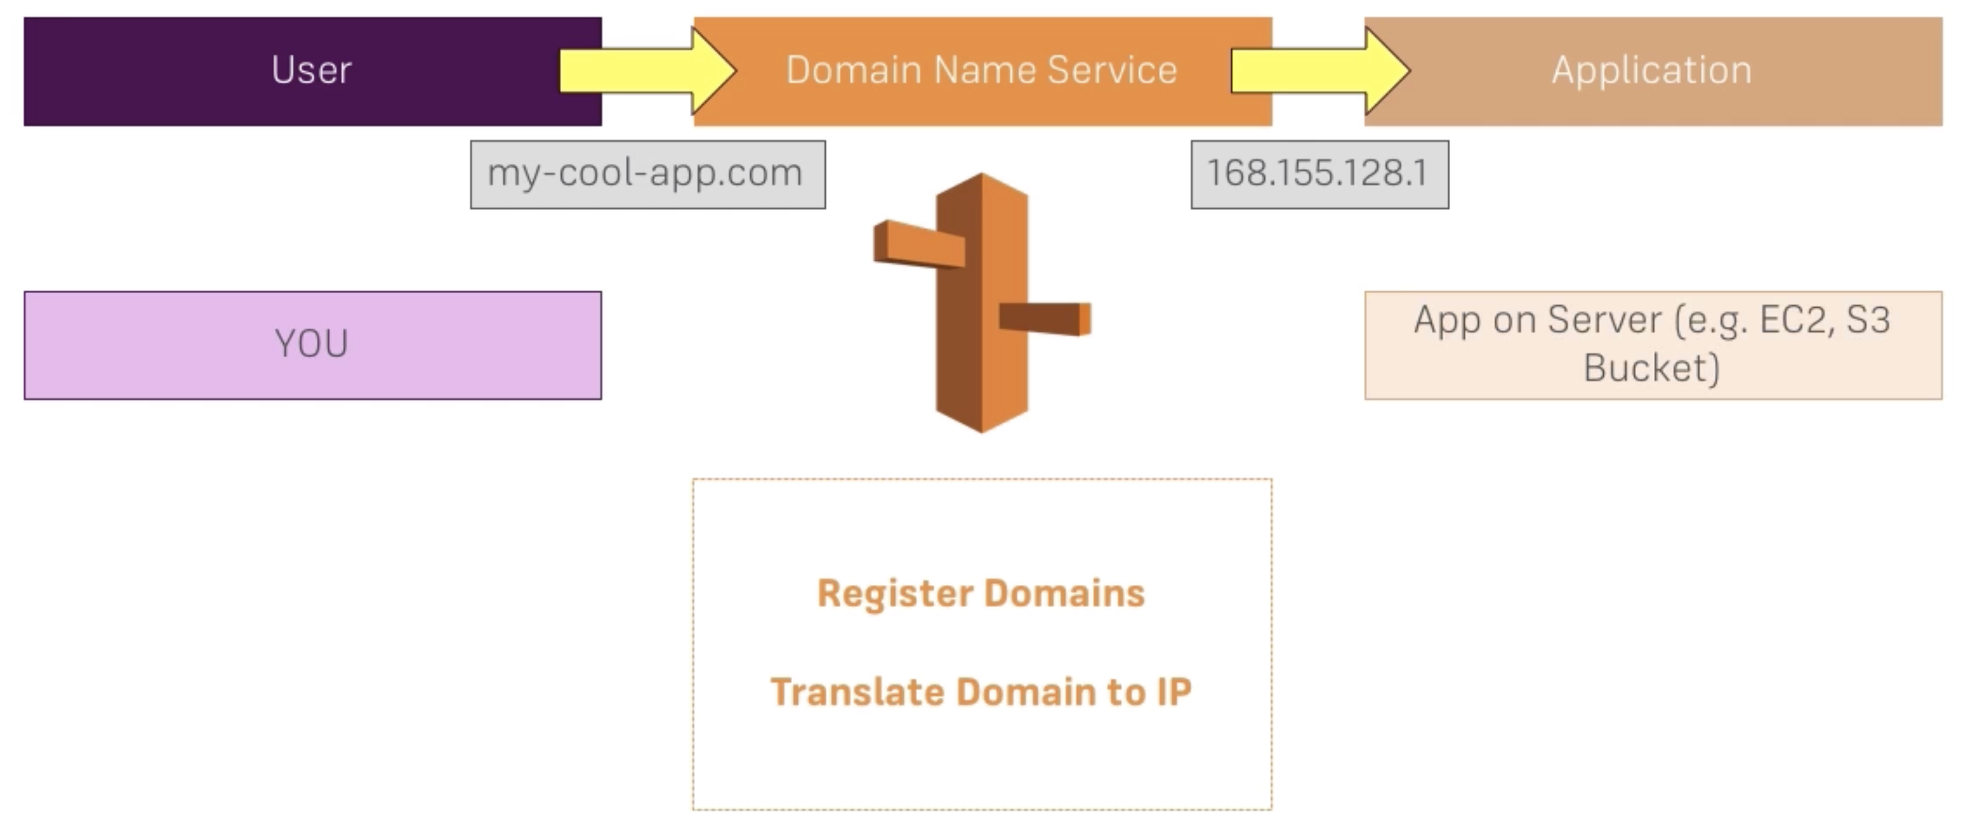
CONSTRAINTS AND LIMITATIONS
AWS ROUTE 53 – HOW IT WORKS

Slide 35
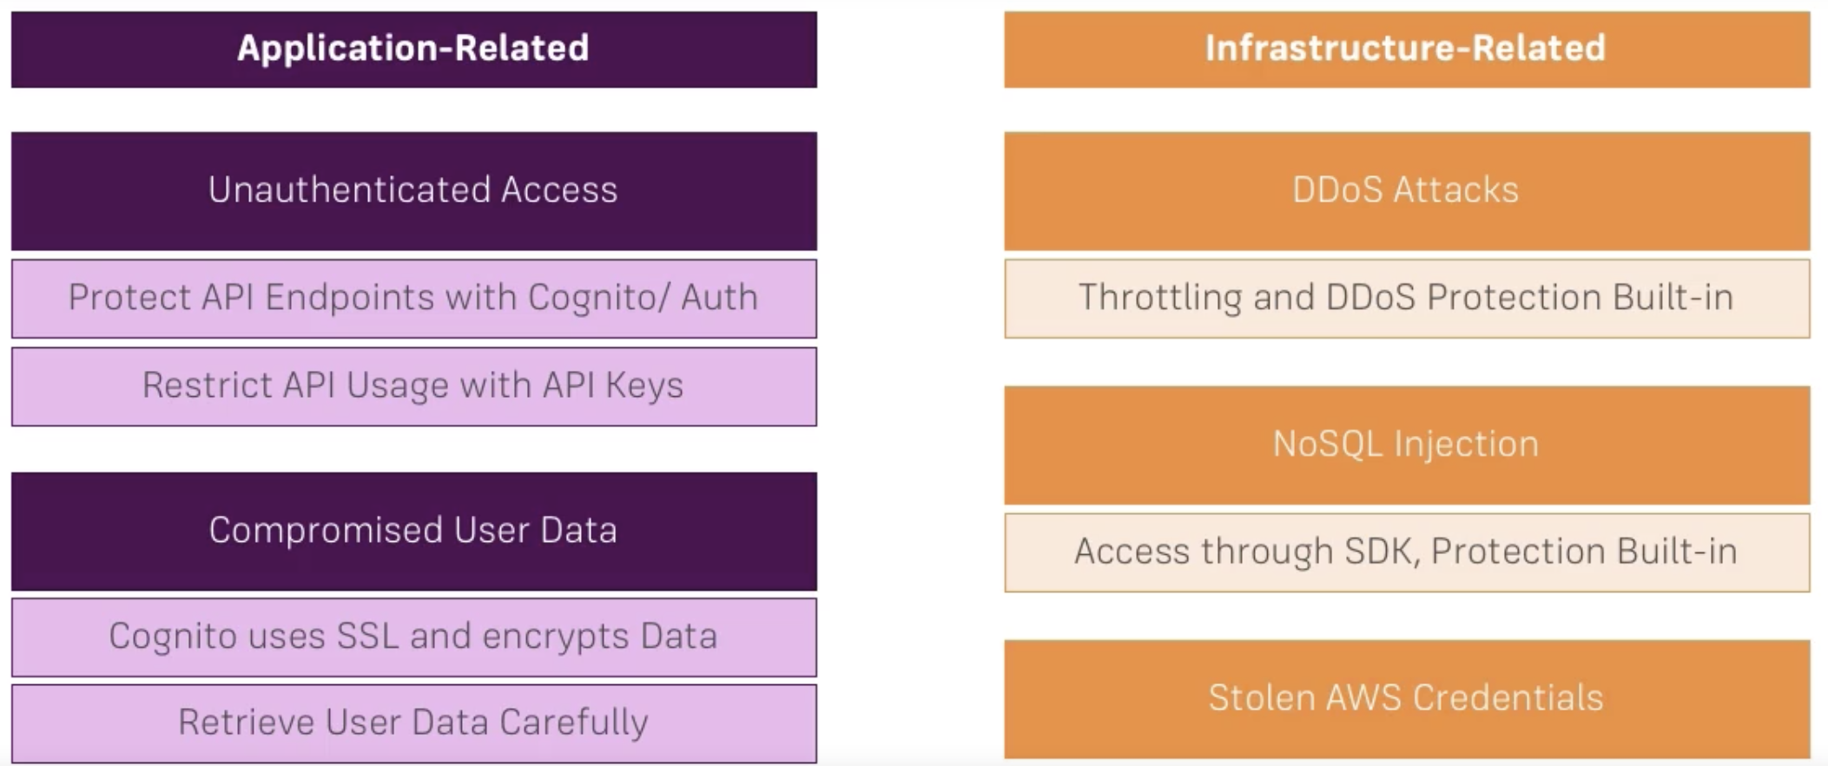
CONSTRAINTS AND LIMITATIONS
SECURITY - DIFFERENT TYPES OF PROTECTION

Slide 36
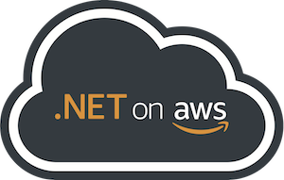
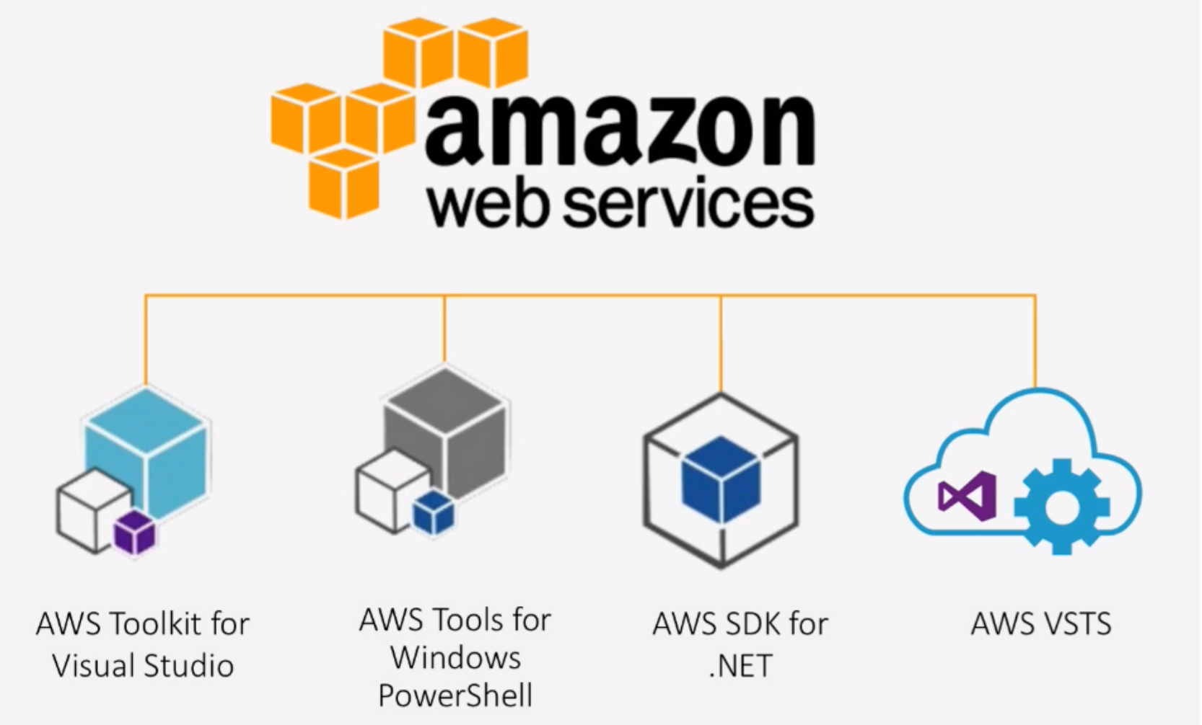
CONSTRAINTS AND LIMITATIONS
AWS TOOLING FOR .NET

Slide 37
CONSTRAINTS AND LIMITATIONS
SELECT AWS ACCESS TYPE
AWS Management Console access
Programmatic access
AWS Command Line Interface (CLI)
Programmatic access AWS SDK for .NET, Java, Python,..
https://docs.aws.amazon.com/sdkfornet/v3/apidocs/

Slide 38
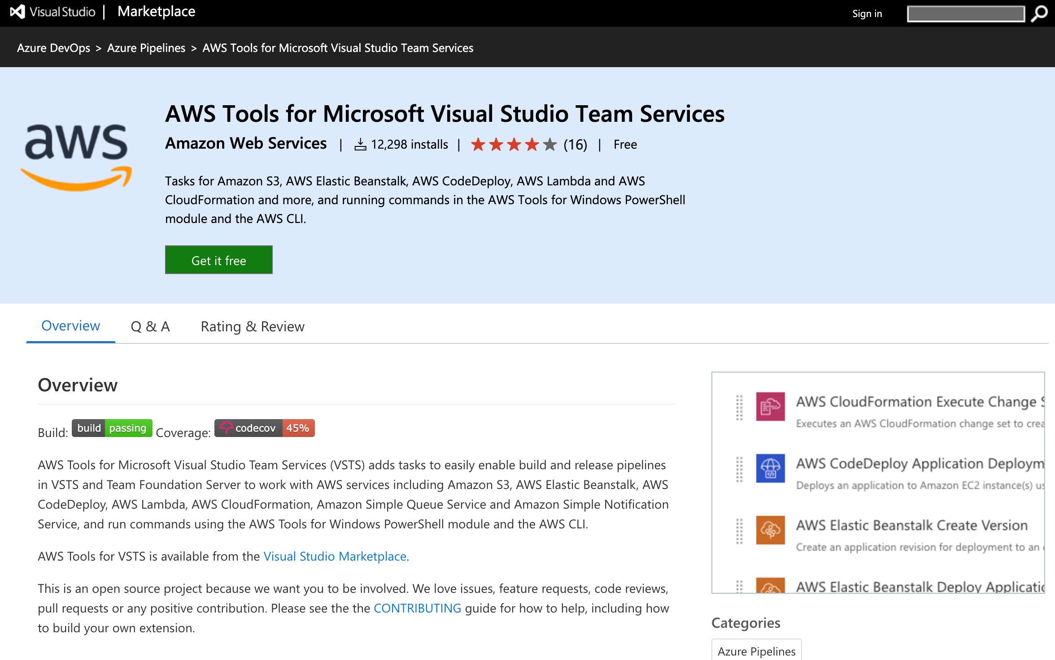
CONSTRAINTS AND LIMITATIONS
AWS TOOLS FOR AZURE DEVOPS

Slide 39
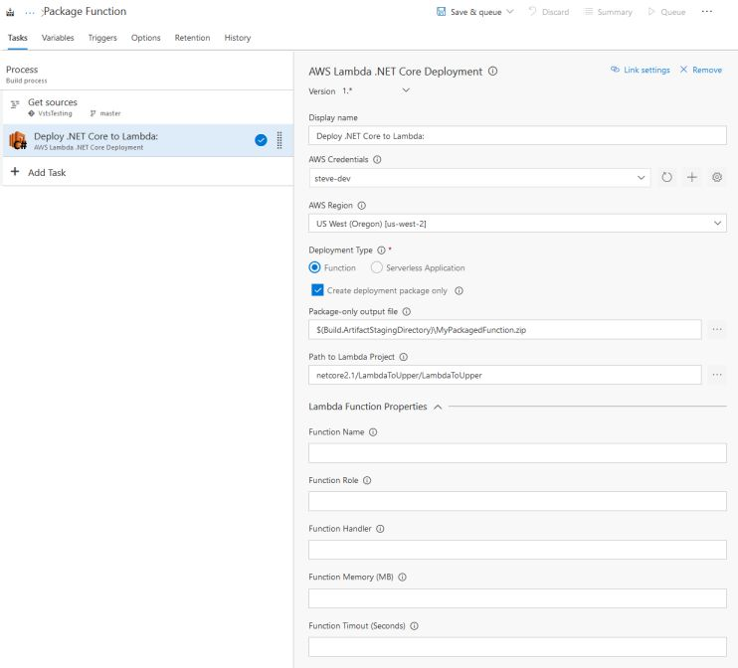
CONSTRAINTS AND LIMITATIONS
.NET CORE LAMBDA DEPLOYMENT the AWS TOOLS for AZURE DEVOPS

Slide 40
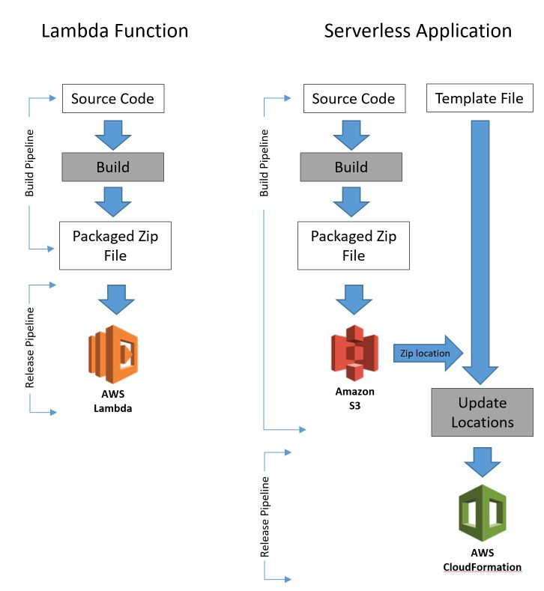
CONSTRAINTS AND LIMITATIONS
.NET CORE LAMBDA DEPLOYMENT the AWS TOOLS for AZURE DEVOPS
https://aws.amazon.com/blogs/developer/net-core-lambda-deployment-task-enhancements-in-the-aws-tools-for-vsts/

Slide 41
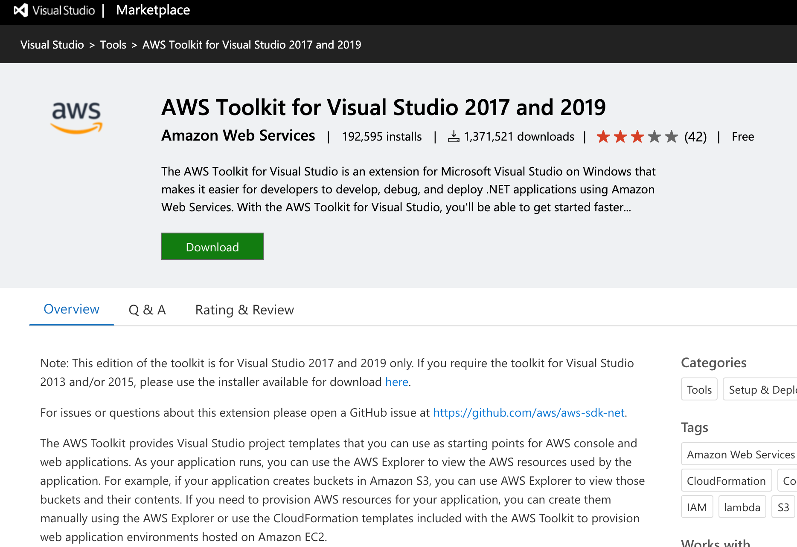
CONSTRAINTS AND LIMITATIONS
AWS TOOLKIT FOR VISUAL STUDIO

Slide 42
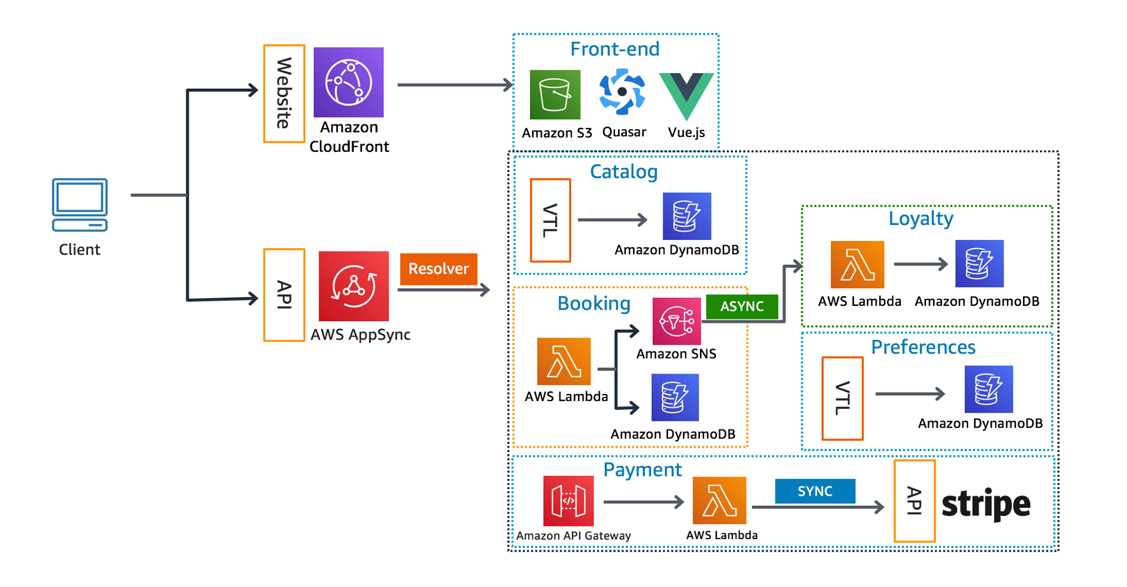
CONSTRAINTS AND LIMITATIONS
AWS SERVERLESS DEPLOYMENT DIAGRAM

Slide 43


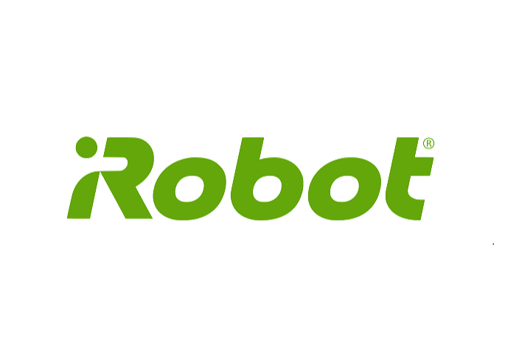
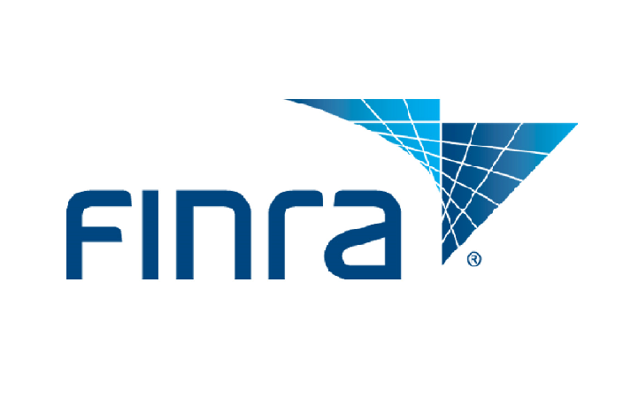


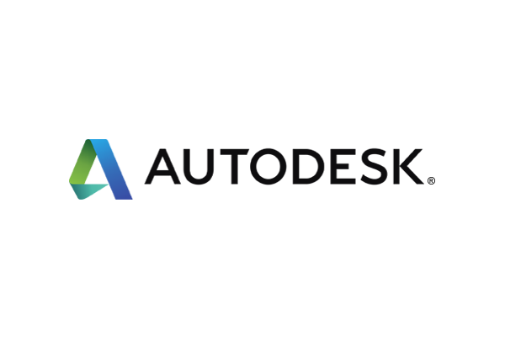

CONSTRAINTS AND LIMITATIONS
CASE STUDIES

Slide 44
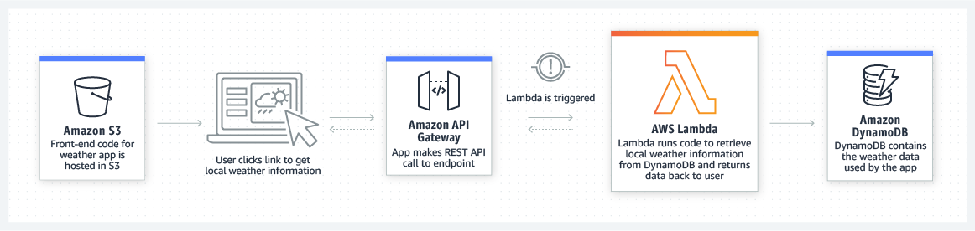
CONSTRAINTS AND LIMITATIONS
WEB APPLICATIONS
By combining AWS Lambda with other AWS services, developers can build powerful web applications that automatically scale up and down and run in a highly available configuration across multiple data centers – with zero administrative effort required for scalability, back-ups or multi-data center redundancy.

Slide 45

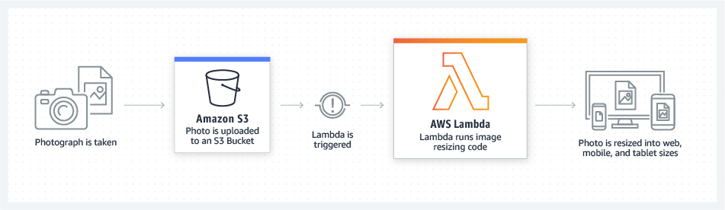
CONSTRAINTS AND LIMITATIONS
REAL-TIME FILE PROCESSING
The Seattle Times uses AWS Lambda to resize images for viewing on different devices such as desktop computers, tablets, and smartphones.

Slide 46

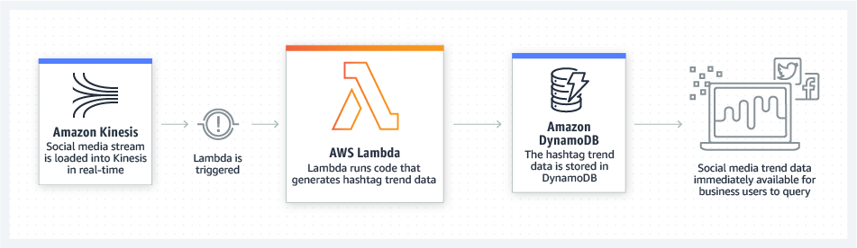
CONSTRAINTS AND LIMITATIONS
REAL-TIME STREAM PROCESSING
Localytics processes billions of data points in real-time, and uses Lambda to process historical and live data stored in S3 or streamed from Kinesis.

Slide 47

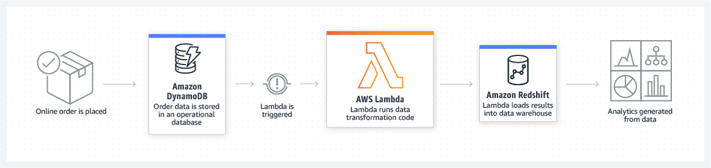
CONSTRAINTS AND LIMITATIONS
EXTRACT, TRANSFORM, LOAD
Zillow uses Lambda and Kinesis to track a subset of mobile metrics in realtime. Perform data validation, filtering, sorting, or other transformations for every data change in a DynamoDB table and load the transformed data to another data store.

Slide 48
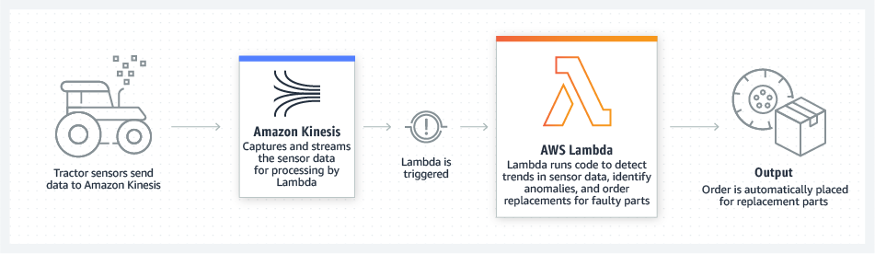
CONSTRAINTS AND LIMITATIONS
IOT BACKENDS
You can build serverless backends using AWS Lambda to handle web, mobile, Internet of Things (IoT), and 3rd party API requests.
Zillow uses Lambda and Kinesis to track a subset of mobile metrics in realtime. Perform data validation, filtering, sorting, or other transformations for every data change in a DynamoDB table and load the transformed data to another data store.

Slide 49
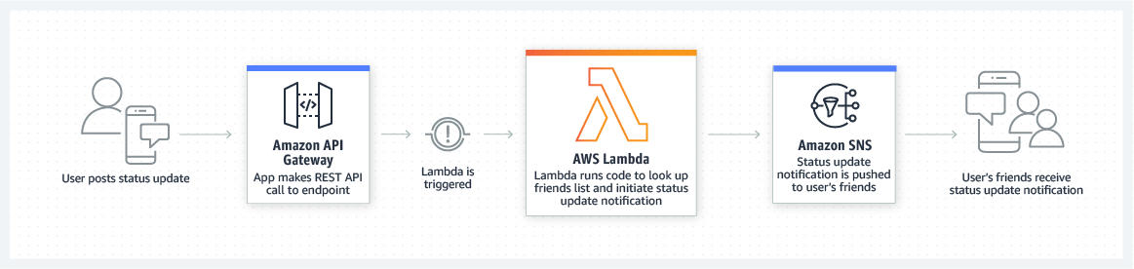
CONSTRAINTS AND LIMITATIONS
MOBILE BACKENDS
You can build backends using AWS Lambda and Amazon API Gateway to authenticate and process API requests. Lambda makes it easy to create rich, personalized app experiences.
Bustle runs a serverless backend for its Bustle iOS app and websites using AWS Lambda and Amazon API Gateway. Serverless architectures allow Bustle to never have to deal with infrastructure management, so every engineer can focus on building out new features and innovating

Slide 50
IS AWS SERVERLESS FOR YOUR APP?
Benefits
Pay for what you use
No infrastructure to manage
Auto-scaling with no configuration needed
Usage Plans
Caching
Authorization
Staging
SDK Generation
API Monitoring
Request Validation
Documentation
Considerations
For apps that may not see traffic for several minutes at a time, you could see cold starts
Cannot use native libraries (aka Addons) unless you package your app on an EC2 machine running Amazon Linux
Stateless only
API Gateway has a timeout of 29 seconds, and Lambda has a maximum execution time of 15 minutes.

Slide 51
THANK YOU FOR ATTENTION! Q&A

